Slide 1
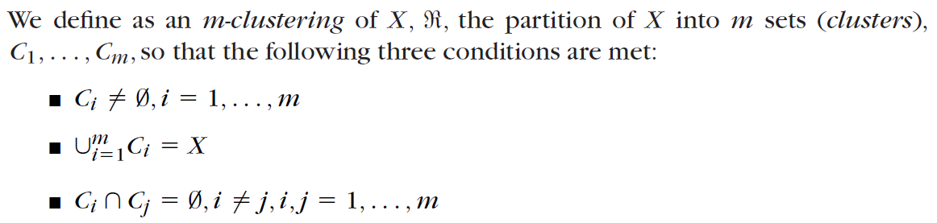
Clustering
Let X be our data set, that is, X {x1, x2, . . . , xN }
the vectors contained in a cluster Ci are “more similar” to each other and “less similar” to the feature vectors of the other clusters

Slide 2
Clustering
Hard or crisp clustering ➔ each vector belongs to a single cluster
What is a good clustering?
Internal (within the cluster) distances should be small
External (intra-cluster) should be large
Clustering is a way to discover new categories (classes)
What we Need for Clustering
Proximity measure, either
Dissimilarity(or distance) measure d(x,y): small if x,y are similar
Similarity measure s(x,y): large if x,y are similar

Slide 3
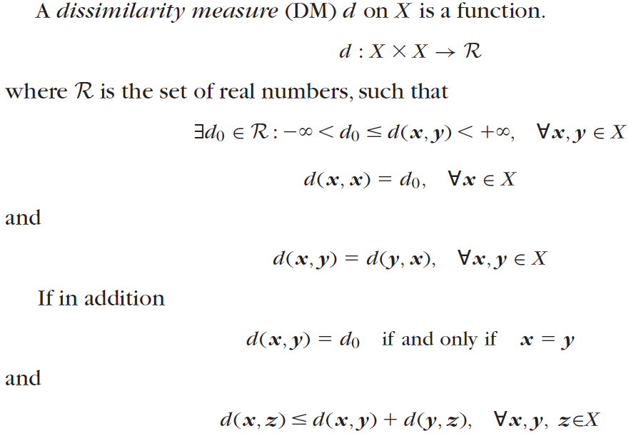
Triangular Inequality

Slide 4
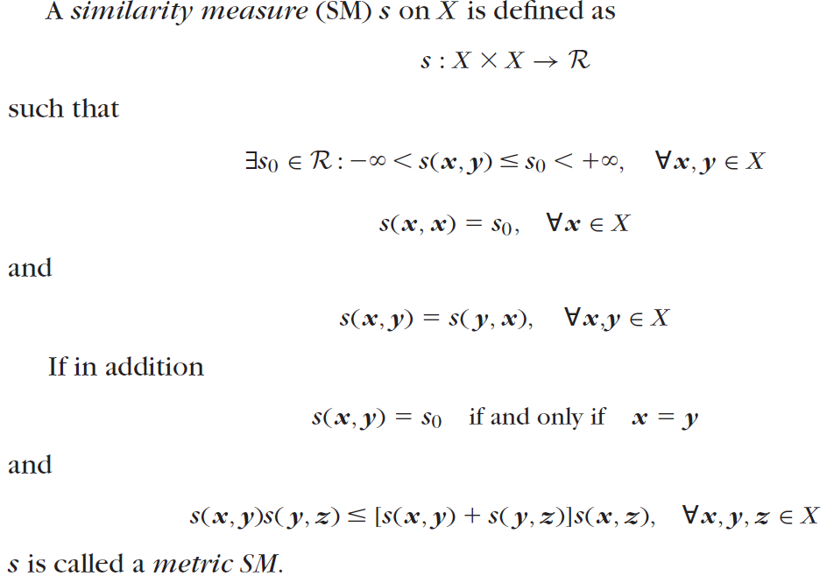

Slide 5
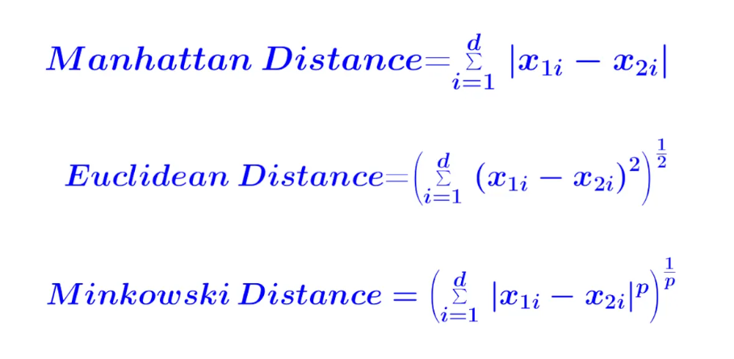
Dissimilarity(or distance) measure d(x,y)
Manhattan distance
Euclidean distance
Minkowski Distances

Slide 6
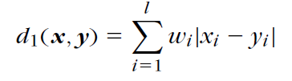
Manhattan distance
Special lp metric DMs that are also encountered in practice are the (weighted) l1 or Manhattan norm,

Slide 7
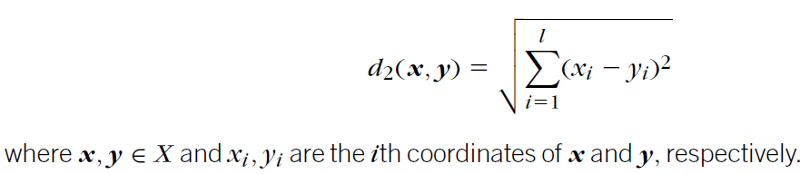
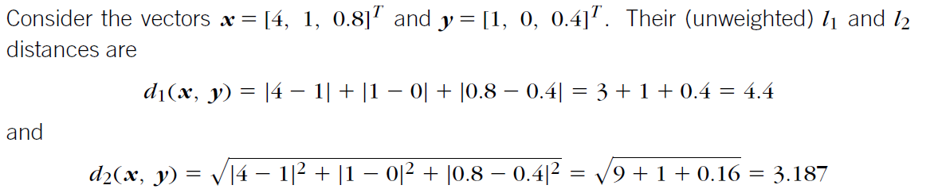
Euclidean distance
This is a dissimilarity measure on X, with d₀ = 0; that is, the minimum possible distance between two vectors of X is 0. Moreover, the distance of a vector from itself is equal to 0. Also, it is easy to observe that d(x, y) d( y, x).

Slide 8
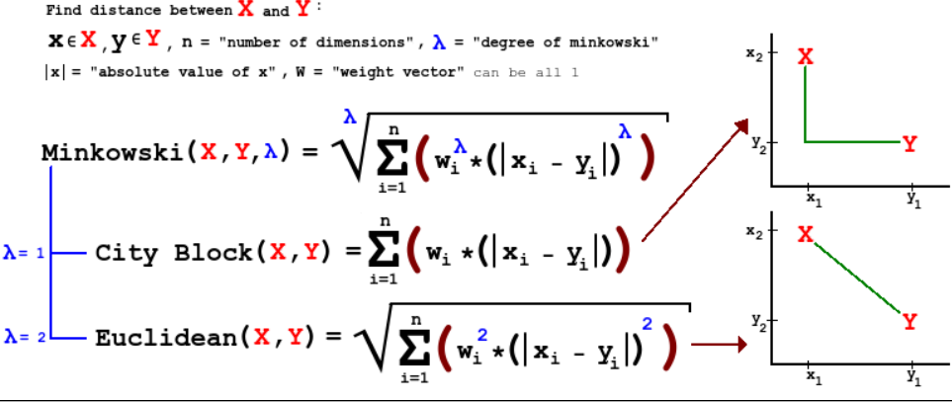
Minkowski Distances

Slide 9
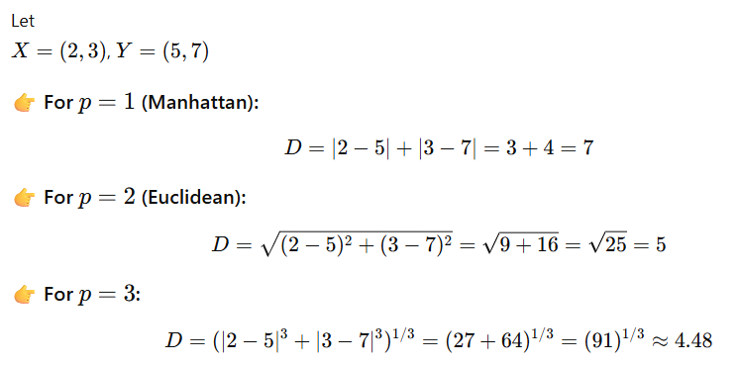
Dissimilarity(or distance) measure d(x,y)

Slide 10
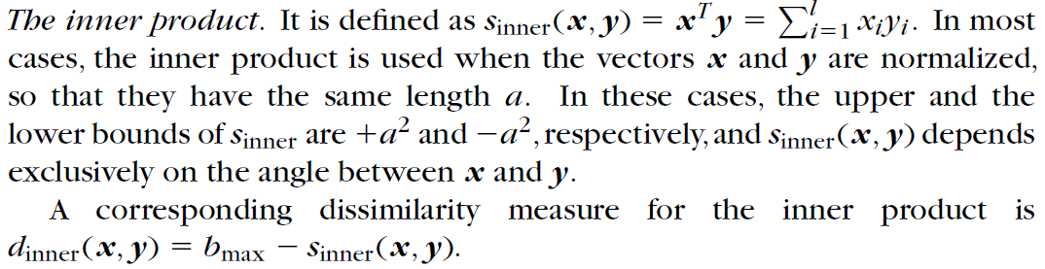
Similarity measure s(x,y)

Slide 11
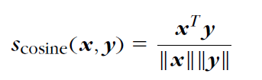
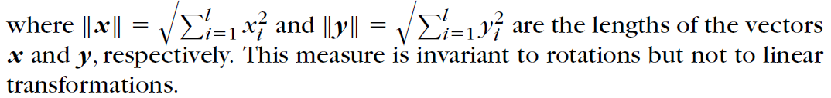
Cosine Similarity
Closely related to the inner product is the cosine similarity measure, which is defined as

Slide 12
Criterion functions for clustering
A criterion function for clustering is a mathematical measure used to evaluate and optimize the quality of clusters formed from a dataset.
Goal:
Minimize similarity within clusters (compactness)
Maximize dissimilarity between clusters (separation)
Types of Criterion Functions
Within-Cluster Sum of Squares (WCSS / SSE)
Between-Cluster Separation
Silhouette Coefficient
Dunn Index
Scatter

Slide 13


1. Within-Cluster Sum of Squares (WCSS / SSE)
Used in K-Means.
Where:
$C_{k}$= cluster k
$μ_{k}$= centroid of cluster k
$x_{i}$= data point
Minimizes variance inside clusters.

Slide 14


2. Between-Cluster Separation
Where:
$n_{k}$= number of points in cluster k
$μ_{k}$= cluster mean
$μ$= global mean
Maximizes distance between clusters.

Slide 15


3. Silhouette Coefficient
Where:
$a\left(i\right)$= average distance within same cluster
$b\left(i\right)$= average distance to nearest cluster
Range: −1 to +1
Higher value = better clustering.

Slide 16


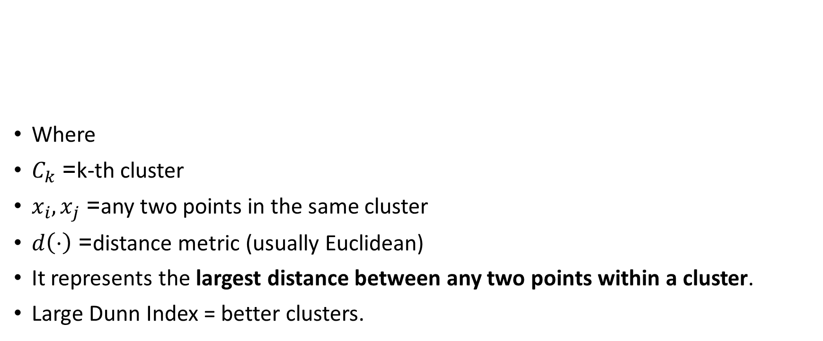
4. Dunn Index
Where
$C_{k}$= k-th cluster
$x_{i},x_{j}$= any two points in the same cluster
$d\left(⋅\right)$= distance metric (usually Euclidean)
It represents the largest distance between any two points within a cluster.
Large Dunn Index = better clusters.

Slide 17


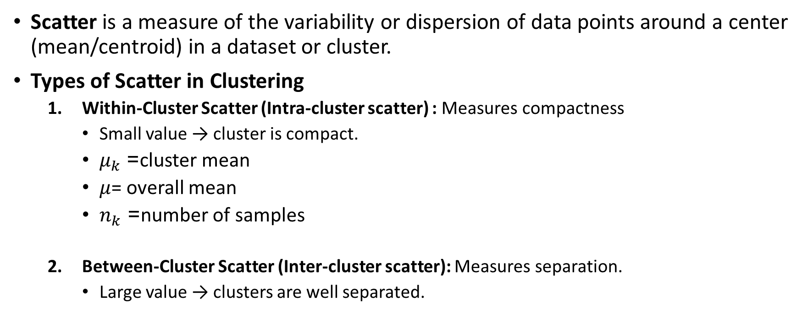
5. Scatter
Scatter is a measure of the variability or dispersion of data points around a center (mean/centroid) in a dataset or cluster.
Types of Scatter in Clustering
Within-Cluster Scatter (Intra-cluster scatter) : Measures compactness
Small value → cluster is compact.
$μ_{k}$= cluster mean
$μ$= overall mean
$n_{k}$= number of samples
Between-Cluster Scatter (Inter-cluster scatter): Measures separation.
Large value → clusters are well separated.

Slide 18
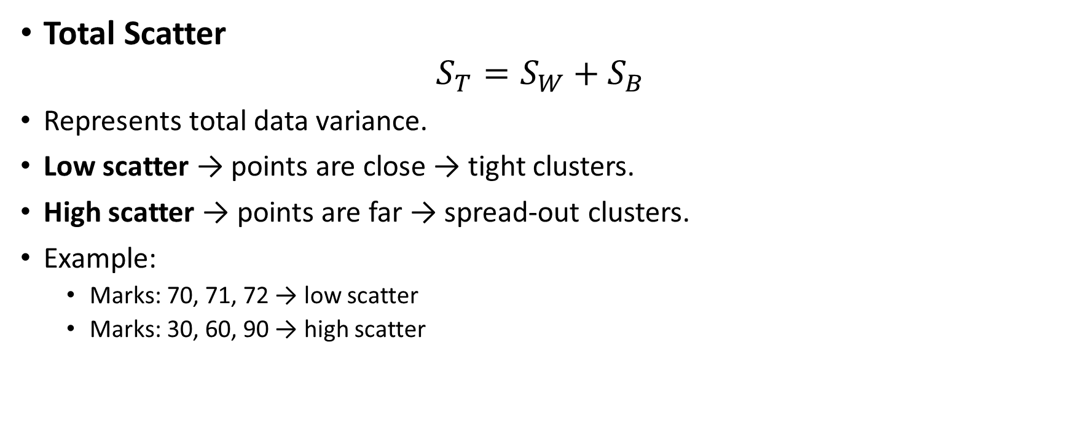
5. Scatter
Total Scatter
$$S_{T}=S_{W}+S_{B}$$
Represents total data variance.
Low scatter → points are close → tight clusters.
High scatter → points are far → spread-out clusters.
Example:
Marks: 70, 71, 72 → low scatter
Marks: 30, 60, 90 → high scatter

